Slide 1

Tic Tac Toe GUI
Af Birk, Karl, Kasper og Stig
(DemderikkeLængereerBagud)

Slide 2
Indholdsfortegnelse
Lavet med Unity UI
Fremvisning af board
Input fra board
Opdatering af board
Valg af spiller og start
Game Restart
Design

Slide 3
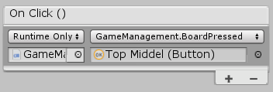
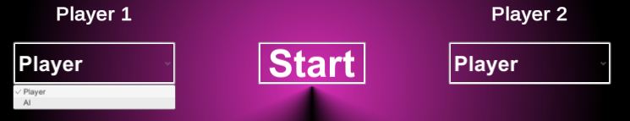
Lavet med Unity UI
Eventsystem
Buttons
Dropdowns

Slide 4
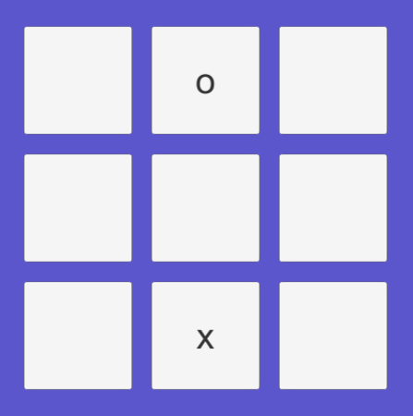
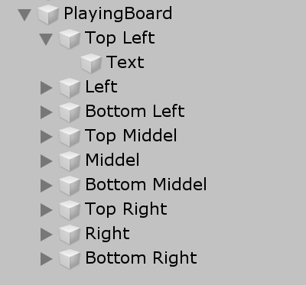
Fremvisning af board
int k = 0;
for (int i = 0; i < 3; i++)
{
for (int j = 0; j < 3; j++)
{
playingFieldText[i, j] = playingBoard.transform.GetChild(k).GetChild(0).GetComponent<Text>();
k++;
}
}

Slide 5
Fremvisning af board
if (currentGame != null && !someoneHasWon)
{
currentPlayerText.text = "Current player: " + currentGame.CurrentPlayer.ToString();
for (int i = 0; i < 3; i++)
{
for (int j = 0; j < 3; j++)
{
if(currentGame[i,j] == Symbol.N)
{
playingFieldText[i, j].text = "";
}
else
{
playingFieldText[i, j].text = currentGame[i, j].ToString();
}
}
}
}

Slide 6
Input fra board
public class UiIplayer : IPlayer
{
GameManagement manager;
public UiIplayer(GameManagement m)
{
manager = m;
}
public Placement NextMove(Game gameState)
{
return manager.LastValidButtonPress();
}
}

Slide 7
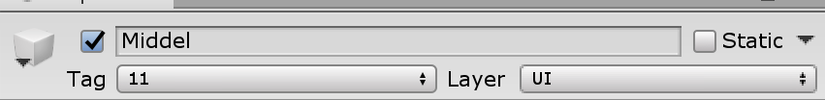
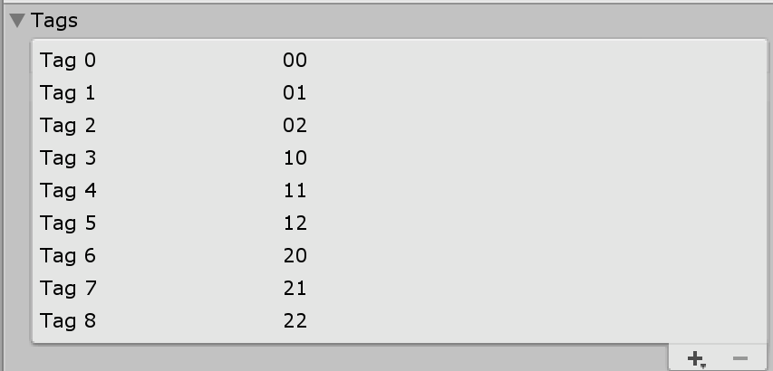
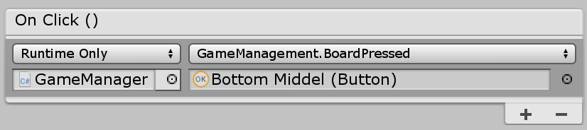
Input fra board
public Placement LastValidButtonPress()
{
userHasPressed = false;
new WaitWhile(() => !userHasPressed);
return lastPlacePressed;
}
public void BoardPressed(Button b)
{
Placement p = new Placement(int.Parse(b.tag[0].ToString()), int.Parse(b.tag[1].ToString()));
if (currentGame.IsLegalMove(p))
{
lastPlacePressed = p;
userHasPressed = true;
StartCoroutine(AutoNextMove());
}
}

Slide 8
Opdatering af board
if (currentGame != null)
{
if (currentGame.IsGameDone)
{
someoneHasWon = true;
if (currentGame.WhoWon() == null)
{
currentPlayerText.text = "The game was a tie";
}
else
{
IPlayer winningPlayer = currentGame.WhoWon();
if (winningPlayer == playerOne)
{
currentPlayerText.text = "X has won the game";
}
else
{
currentPlayerText.text = "O has won the game";
}
}
}
}

Slide 9
Opdatering af board
void NextMove(bool isAi = false)
{
if (userHasPressed || isAi)
{
if (!currentGame.IsGameDone)
{
currentGame.NextMove();
if (currentGame.CurrentPlayer == Symbol.X && playerOneDropdown.value == 1)
{
NextMove(true);
}
else if (currentGame.CurrentPlayer == Symbol.O && playerTwoDropdown.value == 1)
{
NextMove(true);
}
}
}
}
IEnumerator AutoNextMove()
{
new WaitForSeconds(0.5f);
NextMove();
yield return new WaitForSeconds(0.5f);
}

Slide 10
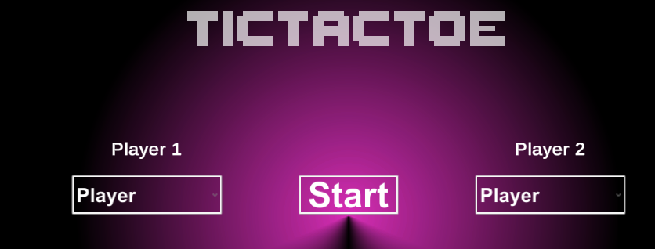
Valg af spiller og start
public void StartGame()
{
currentGame = MakeNewGame();
choosingScreen.SetActive(false);
playingScreen.SetActive(true);
NextMove(xIsAI);
}
Game MakeNewGame()
{
if (playerOneDropdown.value == 0)
{
playerOne = new UiIplayer(this);
}else
{
playerOne = new UffeAIPlayer();
xIsAI = true;
}
if (playerTwoDropdown.value == 0)
{
playerTwo = new UiIplayer(this);
}else
{
playerTwo = new UffeAIPlayer();
}
return new Game(playerOne, playerTwo);
}

Slide 11
Restart Game
public void RestartGame()
{
userHasPressed = false;
someoneHasWon = false;
currentGame = MakeNewGame();
NextMove(xIsAI);
}

Slide 12
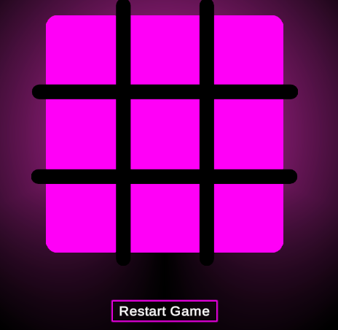
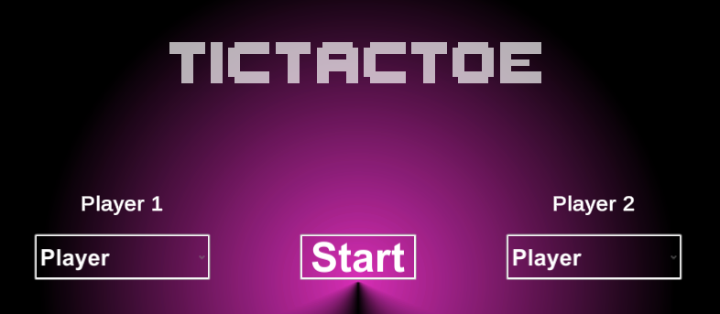
Design
Layout
Start Skærm
Spil Skærm
Border
Font
Ariel
ThaleahFat
LiberationSans SDF
Farver
Lys

Slide 13
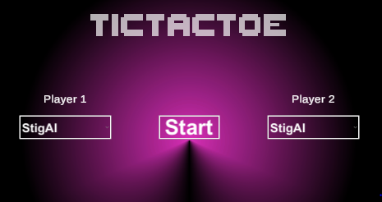
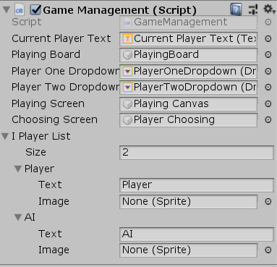
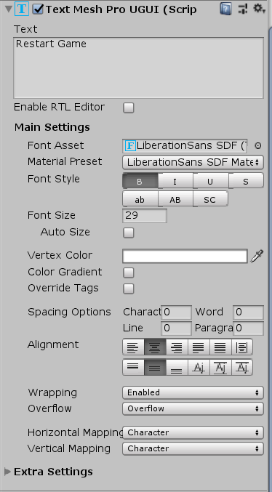
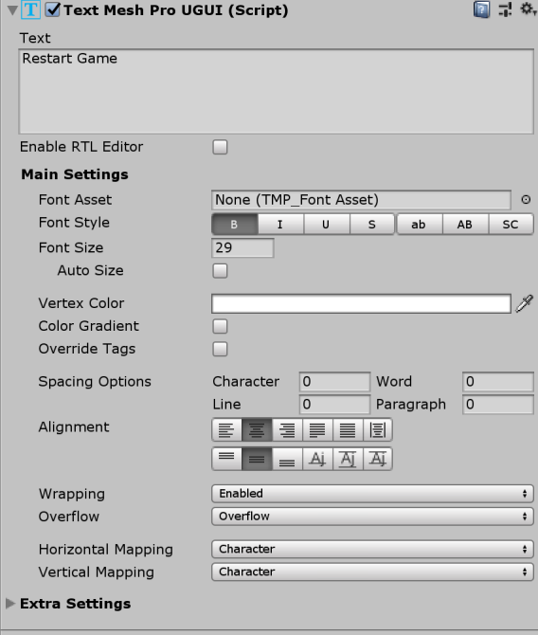
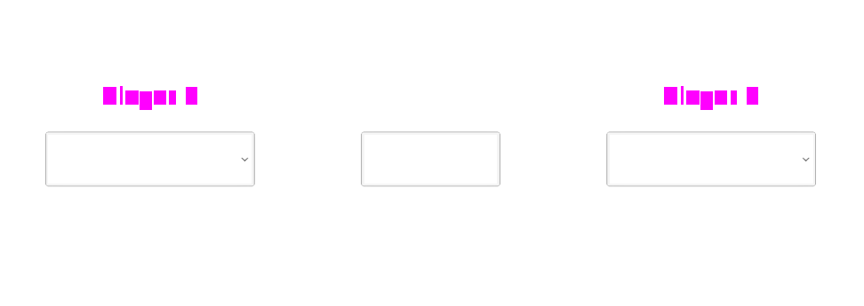
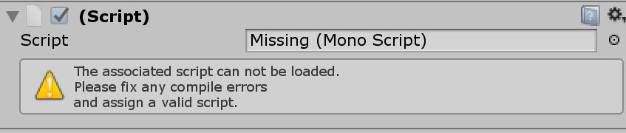
Unity Ulemper
Synkronisering
Prefabs

